Slide 1
Happy New Year 2020
Merry Christmas
Welcome to
Evangelical Christian Church

Slide 2
1. Great is Thy faithfulness,
O God my Father,
There is no shadow of turning with Thee;
Thou changest not, Thy compassions they fail not;
As Thou hast been Thou forever wilt be.
GREAT IS THY FAITHFULNESS
The Hymnal - 43

Slide 3
Great is Thy faithfulness!
Great is Thy faithfulness!
Morning by morning
new mercies I see;
All I have needed Thy hand hath provided--
Great is Thy faithfulness, Lord unto me!

Slide 4
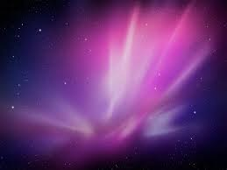
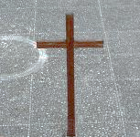
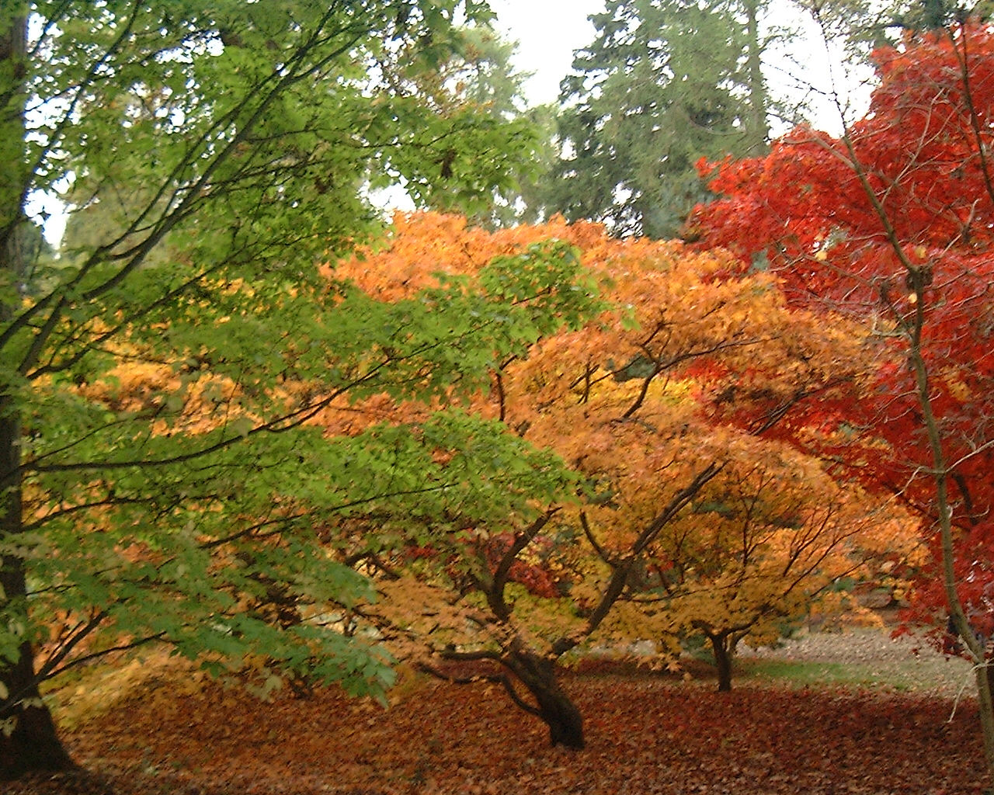
2. Summer and winter, and springtime and
harvest,
Sun, moon and stars in their courses above
Join with all nature in manifold witness,
To Thy great faithfulness, mercy and love.

Slide 5
Great is Thy faithfulness!
Great is Thy faithfulness!
Morning by morning
new mercies I see;
All I have needed Thy hand hath provided--
Great is Thy faithfulness, Lord unto me!

Slide 6
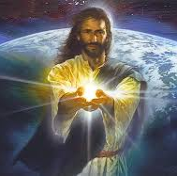
3. Pardon for sin and a peace that endureth,
Thine own dear presence to cheer and to guide;
Strength for today and bright hope for tomorrow,
Blessings all mine, with ten thousand beside!

Slide 7
Great is Thy faithfulness!
Great is Thy faithfulness!
Morning by morning
new mercies I see;
All I have needed Thy hand hath provided--
Great is Thy faithfulness, Lord unto me!
Used by permission C.C.L.# 49565

Slide 8
Testimonies & thanks giving
Special song 1
Hazel Kowalinski
Please keep them brief (maximum 5 min)
in view of time

Slide 9
Message by
Ps. Brian Harper

Slide 10
GUIDE ME O THOU GREAT JEHOVAH
The Hymnal - 51
Guide me O Thou great Jehovah Pilgrim through this barren land. I am weak but Thou art mighty Hold me with thy powerful hand. Bread of heaven Bread of heaven
Feed me till I want no more
Feed me till I want no more

Slide 11
Open now the crystal fountain Whence the healing streams do flow, Let the fiery cloudy pillar Lead me all my journey though, Strong Deliverer Strong Deliverer Be Thou still my strength and shield
Be Thou still my strength and shield

Slide 12
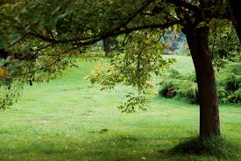
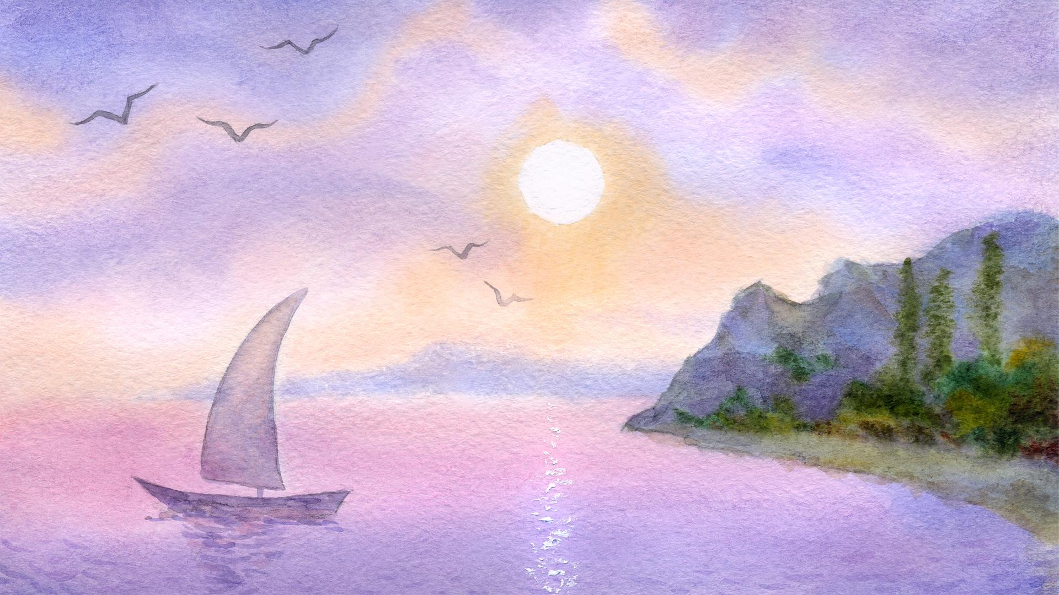
When I tread the verge of Jordan Bid my anxious fears subside Death of death, And hell's destruction, Land me safe on Canaan's side, Songs of praises, Songs of praise
I will ever give to thee I will ever give to thee
Used by permission C.C.L.# 49565

Slide 14
What does it mean to love GOD with your whole heart?
Sunday, 5 January
Ps. Kirby Lancaster

Slide 15
Sunday, 12 January
Ps. Kirby Lancaster

